Slide 1
INVENTORY MANAGEMENT SYSTEM
Internship Duration: Sep-Oct 2025

Slide 2
Problem Statement
Manual inventory tracking leads to in efficiency and errors.
Businesses need a digital solution to manage stock levels and reporting.

Slide 3
Project Objectives
Automate inventory management using Java and JDBC.
Generate CSV reports and send via email notifications.
Implement secure user authentication with OTP verification.
Add stock monitoring and alert system for low inventory.

Slide 4
Technology Stack
Java, JDBC, MySQL.
IntelliJ IDEA , GitHub.
Junit, Mockito.
CSV File Handling, JavaMail API for Email.

Slide 5
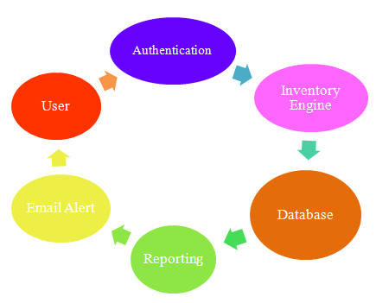
System Architecture

Slide 6
Implements DAO Pattern for database interactions.
Layered architecture for scalability and maintainability.

Slide 7
Modules Implemented
Inventory Tracking Engine.
User Authentication & OTP Verification.
Reporting & CSV Integration.
Stock Alerts & Management Coach.

Slide 8
Implementation Details
Applied Object-Oriented Design principles ( Encapsulation ,Abstraction).
DAO pattern for clean separation of data access logic.
Used Exception Handling for stable runtime operations.
CSVHelper and EmailService for automated reporting and communication.

Slide 9
Key Features/ Demo
Console-based interface for product management.
Role-based authentication for Admin and User.
Email – based OTP verification during registration.
Automatic stock alert and CSV report generation.

Slide 10
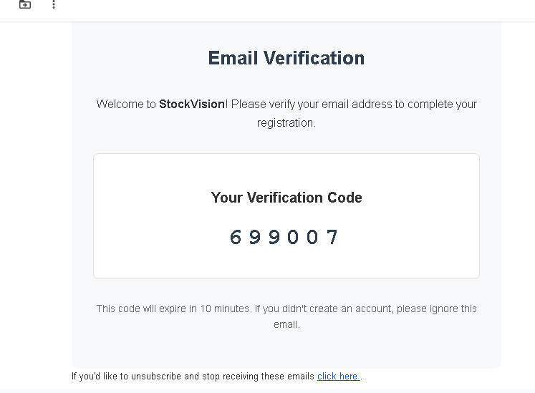
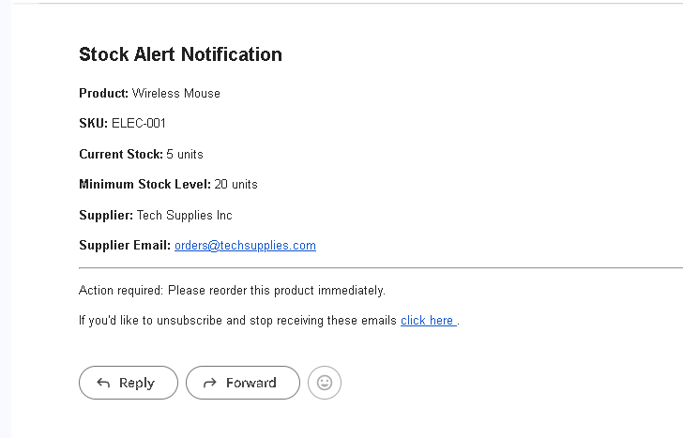
Email Verification
Stock Alert Notification

Slide 11
Testing & Deployment
Unit tests with JUnit and Mockito.
Database tested using mock and in-memory connections.
Application packaged as executable JAR using Maven.
Deployable on any system with Java runtime environment.

Slide 12
Challenges & Learnings
Database connectivity and exception handling issues.
Integration between JDBC, Email API , and CSV export.
Improved understanding of SDLC and Agile methodology.
Team collaboration and version control using GitHub.

Slide 13
Future Enhancements
Migrate to Spring Boot Web application.
Deploy system on AWS or Azure Cloud.
Add dashboard UI for analytics and visualization.

Slide 14
Thank You!
GitHub Link : https://github.com/amitha205012/Inventory-Monitoring-Reporting-System.git

